Slide 1

Modeling the Relationship Between Methane Concentration and Sample Depth in Antarctic Ice Cores
Dan Groeneveld

Slide 2
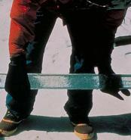

Introduction
Origin and reason for collection of data.

Slide 3

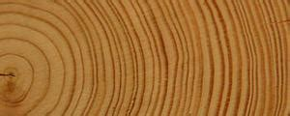
Introduction
My interest in the data

Slide 4
Research Question
How do methane concentrations (in ppbv) vary as a function of depth (m)?

Slide 5
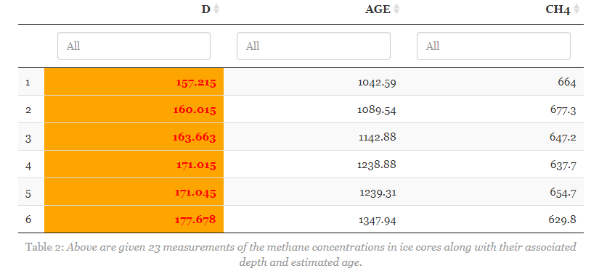
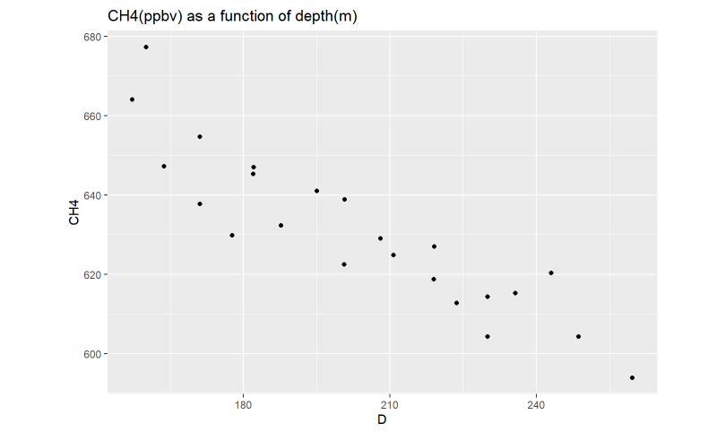
The Data

Slide 6
Assumptions and Validity of Model

Slide 7
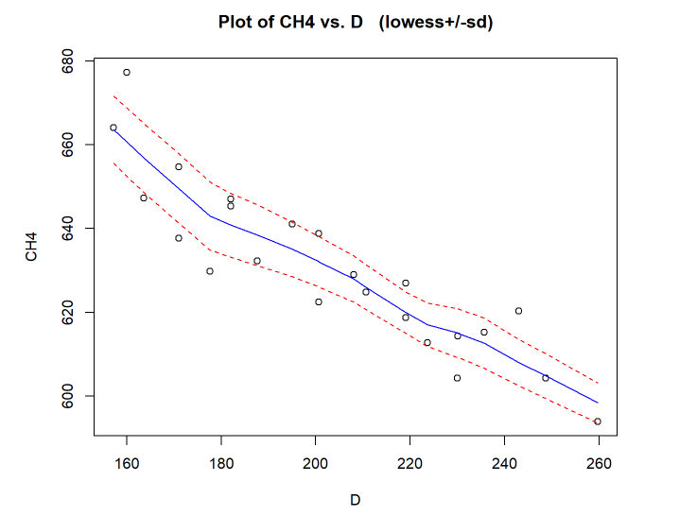
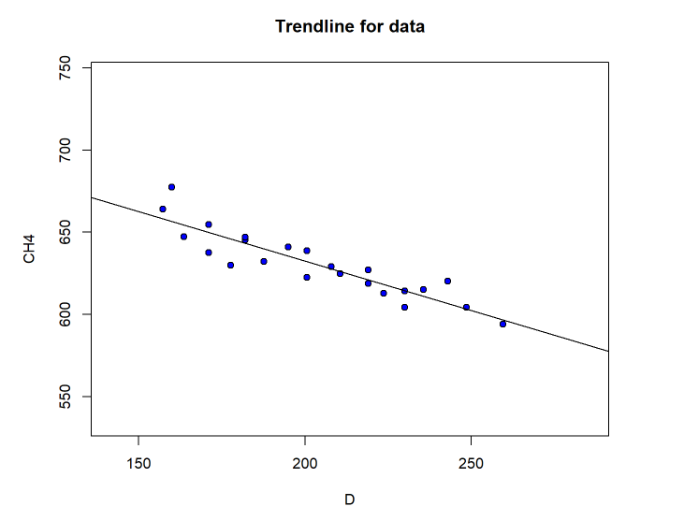
Checking Linearity

Slide 8
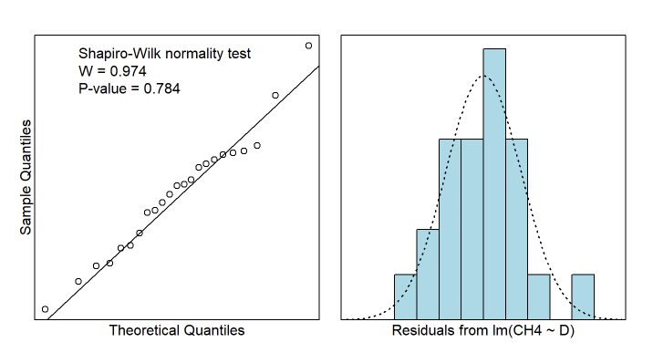
Normality of Error Distribution

Slide 9
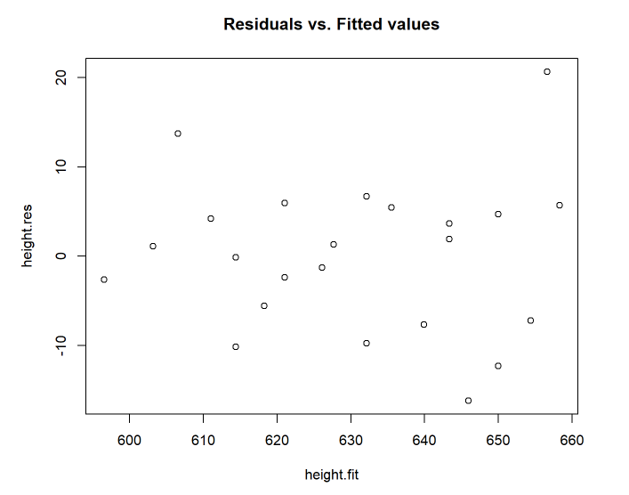
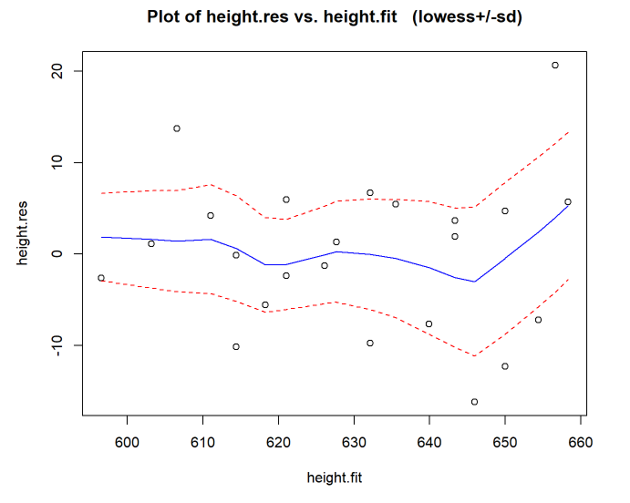
Residuals

Slide 10
Independence
Method of data collection ensures independence

Slide 11
Linear Model
Given the validity of a linear model for this data, the below equation was achieved.
CH4 = 753.0880 – 0.6028D

Slide 12
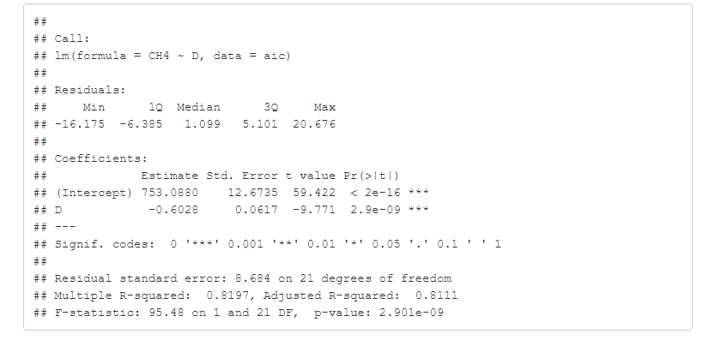
Linear Model

Slide 13
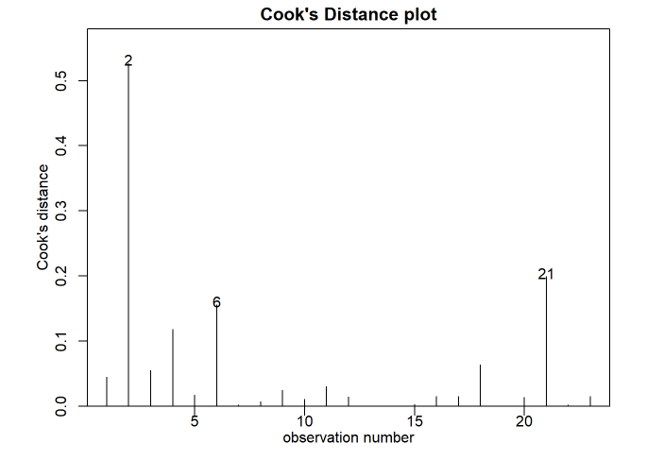
Outliers

Slide 14
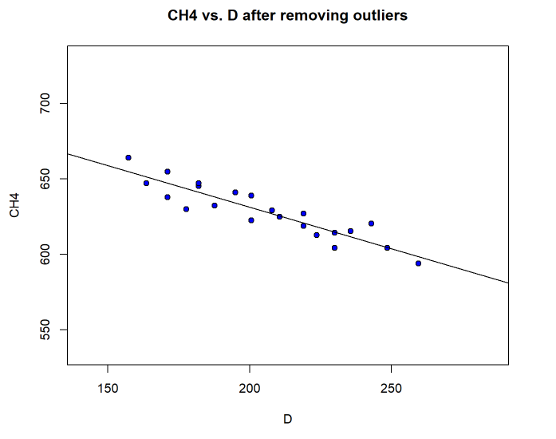
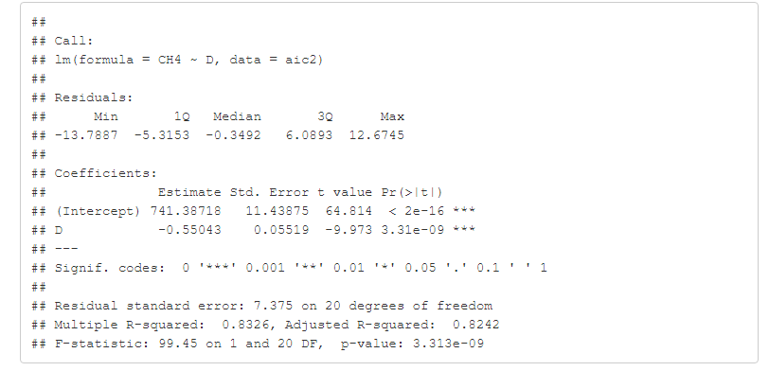
Linear Model Without Outliers

Slide 15
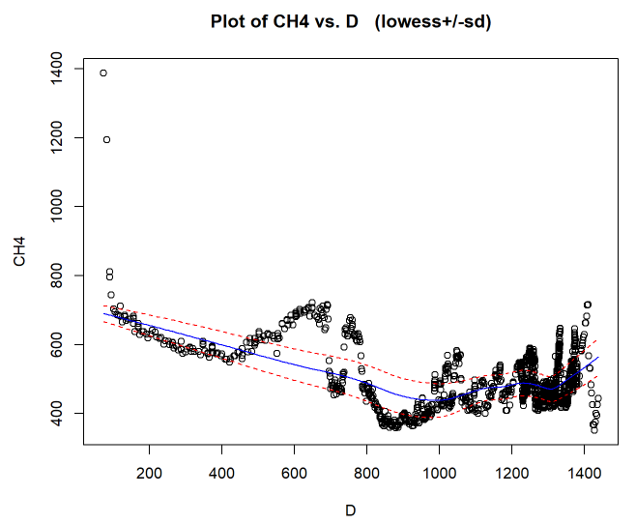
Improving Model
More measurements
Difficulty in modeling

Slide 16
Conclusions
A linear model is valid for this data
Every meter down in the ice marks a 0.6028 ppbv decrease in CH4 concentration
This model is only accurate for the given range of depths (157 – 260 m)
Increase number of measurements for a better model

Slide 17
Predictions Using Model
What is the CH4 concentration in ppbv of an ice core taken at 225 m?
617.4476!

Slide 18
References
“NOAA Logo.” National Weather Service, www.weather.gov/images/pbz/features/noaa-logo-clear1.png.
“Ice Core.” National Centers for Environmental Information, www.ncdc.noaa.gov/sites/default/files/styles/full_page_width/public/icecore-measure.jpg?itok=b7aPvWcf.
Tree Ring. tse1.mm.bing.net/th?id=OIP.HfvC7DW_DGtRr8l8RfRdjwAAAA&amp;pid=Api.
L. Bazin, A. Landais, B. Lemieux-Dudon, H. Toyé Mahamadou Kele, D. Veres, F. Parrenin, P. Martinerie, C. Ritz, E. Capron, V. Lipenkov, M.-F. Loutre, D. Raynaud, B. Vinther, A. Svensson, S.O. Rasmussen, M. Severi, T. Blunier, M. Leuenberger, H. Fischer, V. Masson-Delmotte, J. Chappellaz, and E.Wolff. 2013. An optimized multi-proxy, multi-site Antarctic ice and gas orbital chronology (AICC2012): 120-800 ka. Climate of the Past, Vol. 9, Issue 4, pp. 1715-1731. DOI: 10.5194/cp-9-1715-2013

